Slide 1
TVB-epilepsy: extending TVB to predict patient-specific epileptic seizure propagation
Dr. Dionysios Perdikis

Slide 2
TVB
TheVirtualBrain (TVB) is a neuroinformatics platform (in the form of an open source Python package) for full brain network simulations using biologically realistic connectivity (see thevirtualbrain.org).
Based on generative model simulation, TVB links the anatomical structure of an individual’s brain large-scale networks, obtained via Diffusion Tensor Imaging, to observable functionality, i.e., neuroimaging signals ((f)MRI, (s)EEG and MEG) measured experimentally or clinically.
Thus, TVB enables the model-based inference of neurophysiological mechanisms across different brain scales that underlie healthy as well as pathological brain function.

Slide 3
TVB-epilepsy
TVB-epilepsy (see https://github.com/the-virtual-brain/tvb-epilepsy), is a TVB module that extends TVB functionality with statistical inference techniques, aiming at facilitating the use of TVB for epilepsy applications by academic and clinical researchers alike.
Building on recent research on the dynamical mechanisms of seizure onset and propagation via permittivity coupling, TVB-epilepsy uses TVB to construct a dynamical brain network model of seizure energy propagation from patient’s (d)MRI data.
TVB-epilepsy extends the dynamical model to a relevant statistical one and inverts it by contrasting its predictions to SEEG clinical data.
Thus, TVB users can fit neurophysiologically relevant network parameters, the most important of which, namely the pathological excitability of each brain region, directly points to the EZ.
For statistical inference, TVB-epilepsy includes an interface to STAN, a state-of-the-art platform for statistical modeling and high-performance statistical computation (see mc-stan.org).

Slide 4
Tests and documentation still in progress...
See tvb-epilepsy/tvb_epilepsy/top:
notebooks
examples
for some help in using the package, and
scripts for guidance and for helper functions for a more advanced use.
The notebook:
https://github.com/the-virtual-brain/tvb-epilepsy/blob/master/tvb_epilepsy/top/notebooks/tvb_epilepsy_tutorial.ipynb
exemplifies most of the current functionality of the package.

Slide 5
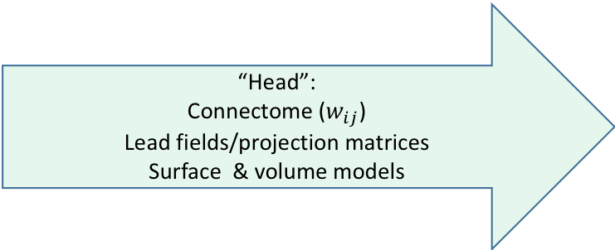
Virtual Epileptic Patient (VEP): Process & software
Virtual Epileptic Model reconstruction pipeline
tvb-recon
Clinician’s Hypothesis Exc and/or E
Virtual Epileptic Model LSA, simulation, (statistical investigation and inversion, stimulation)
tvb-epilepsy
MRI, DTI, SEEG/EEG/MEG/fMRI sensor locations
SEEG/EEG/MEG/fMRI
Diagnosis on pathological excitability and/or epileptogenicity
Fine-tuning
Model,
Results…
Inversion
Simulation
Stimulation
“Head”:
Connectome ($w_{ij}$)
Lead fields/projection matrices
Surface & volume models
Propagation patterns prediction,
SEEG implantation
LSA
Simulation

Slide 6
tvb-epilepsy: An open-source module of TVB epileptic patient methods https://github.com/the-virtual-brain/tvb-epilepsy
Works on the input of a TVB patient folder. It requires optionally clinical hypothesis information and seeg data.
Repertoire of Epileptor models (TVB Epileptor, EpileptorDP2D, EpileptorDP6D, EpileptorDPrealistic)
Some (symbolic) computations, e.g., equilibrium point calculation, jacobians etc
Linear Stability Analysis (LSA) aiming to a first approximation of seizure propagation
Simulations using TVB simulator
Parameter searches of LSA and Simulations with deterministic parameter grids or probabilistic parameter sampling (and Sensitivity Analysis using SALiB in development).
Extension of TVB Epileptor dynamical models and their parameters, connectivity etc to probabilistic parameters and models
Model inversion module with algorithms to select seeg data and active brain nodes for fitting
Interface and cmdstan software of probabilistic programming
Reading TVB patient folders/files, writing-reading to/from .h5 files, plotting routines
TODO: metrics on simulations, stimulation, surgeries…

Slide 7
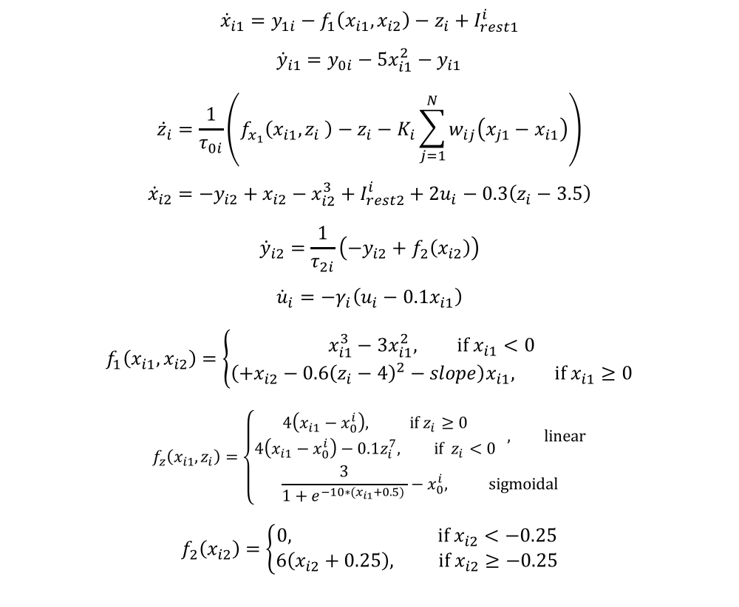
The 6D Epileptor with permittivity coupling
$${\dot{x}}_{i1}=y_{1i}−f_{1}\left(x_{i1},x_{i2}\right)−z_{i}+I_{rest1}^{i}$$
$${\dot{y}}_{i1}=y_{0i}−5x_{i1}^{2}−y_{i1}$$
$${\dot{z}}_{i}=\frac{1}{τ_{0i}}\left(f_{x_{1}}\left(x_{i1},z_{i} \right)−z_{i}−K_{i}\sum_{j=1}^{N}{w_{ij}\left(x_{j1}−x_{i1}\right)}\right)$$
$${\dot{x}}_{i2}={−y}_{i2}+x_{i2}−x_{i2}^{3}+I_{rest2}^{i}+2u_{i}−0.3\left(z_{i}−3.5\right)$$
$${\dot{y}}_{i2}=\frac{1}{τ_{2i}}\left({−y}_{i2}+f_{2}\left(x_{i2}\right)\right)$$
$${\dot{u}}_{i}=−γ_{i}\left(u_{i}−0.1x_{i1}\right)$$
$$f_{1}\left(x_{i1},x_{i2}\right)=\left\{\begin{matrix}x_{i1}^{3}−3x_{i1}^{2}, if x_{i1}<0 \\ \left({+x}_{i2}−0.6{\left(z_{i}−4\right)}^{2}−slope\right)x_{i1}, if x_{i1}≥0\end{matrix}\right.$$
$$f_{z}\left(x_{i1},z_{i}\right)=\left\{\begin{matrix}\begin{matrix}4\left(x_{i1}−x_{0}^{i}\right), if{ z}_{i}≥0 \\ 4\left(x_{i1}−x_{0}^{i}\right)−0.1z_{i}^{7}, if{ z}_{i}<0\end{matrix} , linear \\ \frac{3}{1+e^{−10∗(x_{i1}+0.5) }}−x_{0}^{i}, sigmoidal\end{matrix}\right.$$
$$f_{2}\left(x_{i2}\right)=\left\{\begin{matrix}0, if x_{i2}<−0.25 \\ 6\left(x_{i2}+0.25\right), if x_{i2}≥−0.25\end{matrix}\right.$$

Slide 8
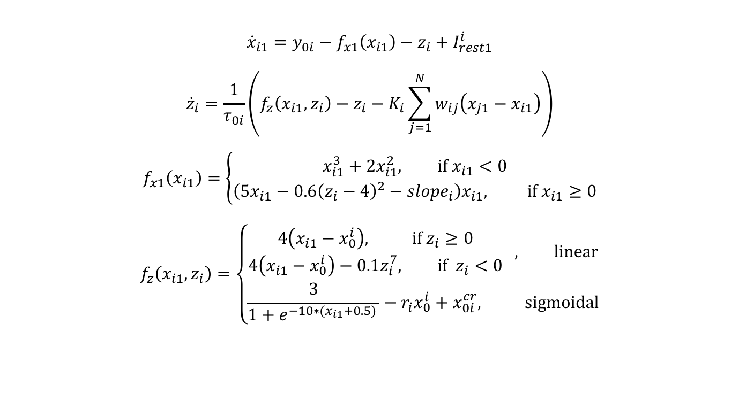
The 2D Epileptor with permittivity coupling
$${\dot{x}}_{i1}=y_{0i}−f_{x1}\left(x_{i1}\right)−z_{i}+I_{rest1}^{i}$$
$${\dot{z}}_{i}=\frac{1}{τ_{0i}}\left(f_{z}\left(x_{i1},z_{i}\right)−z_{i}−K_{i}\sum_{j=1}^{N}{w_{ij}\left(x_{j1}−x_{i1}\right)}\right)$$
$$f_{x1}\left(x_{i1}\right)=\left\{\begin{matrix}x_{i1}^{3}+2x_{i1}^{2}, if x_{i1}<0 \\ \left(5x_{i1}−0.6{\left(z_{i}−4\right)}^{2}−{slope}_{i}\right)x_{i1}, if x_{i1}≥0\end{matrix}\right.$$
$$f_{z}\left(x_{i1},z_{i}\right)=\left\{\begin{matrix}\begin{matrix}4\left(x_{i1}−x_{0}^{i}\right), if{ z}_{i}≥0 \\ 4\left(x_{i1}−x_{0}^{i}\right)−0.1z_{i}^{7}, if{ z}_{i}<0\end{matrix} , linear \\ \frac{3}{1+e^{−10∗(x_{i1}+0.5) }}−r_{i}x_{0}^{i}+x_{0i}^{cr}, sigmoidal\end{matrix}\right.$$

Slide 9
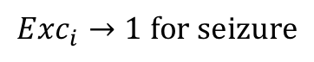
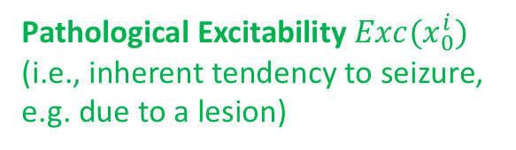
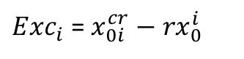
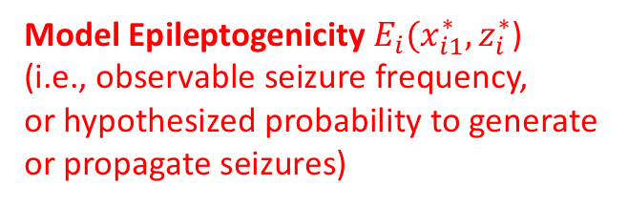
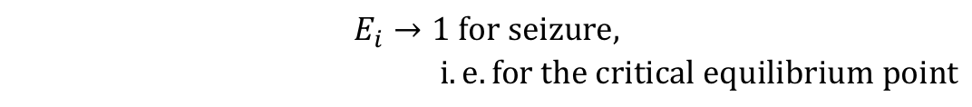

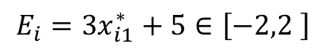
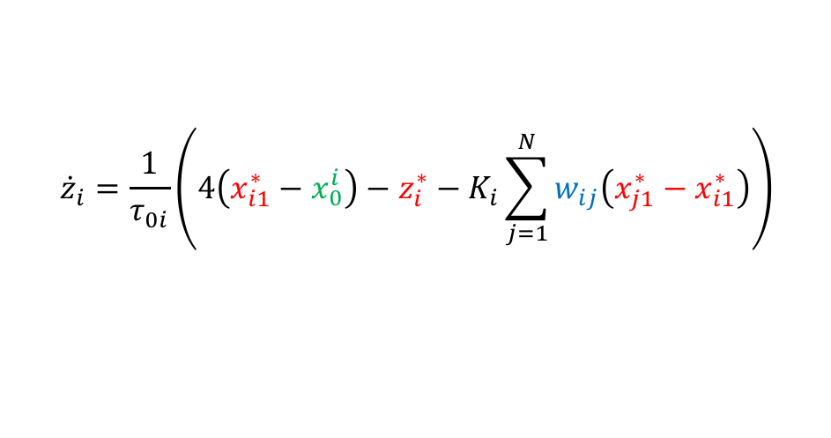
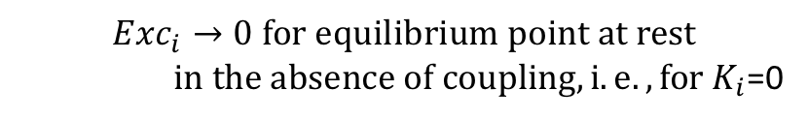
Basic concepts
For seizure propagation the z equation is the most important, containing the connectivity and the node excitability parameters.
So, assuming brain at rest just before seizure onset we define the following concepts
$${\dot{z}}_{i}=\frac{1}{τ_{0i}}\left(4\left(x_{i1}^{∗}−x_{0}^{i}\right)−z_{i}^{∗}−K_{i}\sum_{j=1}^{N}{w_{ij}\left(x_{j1}^{∗}−x_{i1}^{∗}\right)}\right)$$
$$w_{ij}$$
Pathological Excitability ${Exc(x}_{0}^{i})$
(i.e., inherent tendency to seizure, e.g. due to a lesion)
Connectivity
Model Epileptogenicity$E_{i}(x_{i1}^{∗},z_{i}^{∗}$)
(i.e., observable seizure frequency,
or hypothesized probability to generate
or propagate seizures)
${Exc}_{i}$ = $x_{0i}^{cr}−{rx}_{0}^{i}$
$${Exc}_{i}→1 for seizure$$
$$E_{i}=3x_{i1}^{∗}+5∈\left[−2,2 \right]$$
$$E_{i}→1 for seizure,$$
$i.e. for the critical equilibrium point$
$${Exc}_{i}→0 for equilibrium point at rest$$
$in the absence of coupling, i.e., for K_{i}$=0

Slide 10
VEP workflow
Parameter Exploration / Sensitivity Analysis
Dynamical Model
Clinician’s Hypothesis
(Exc(x0), E(x1eq, zeq), w)
Model Configuration
(Exc(x0), E(x1eq, zeq), w)
Simulations
Time Series
TVB input
Estimates
Linear Stability Analysis
LSA
propagation strength
Priors
Model inversion
(data fitting)…
Fitting results
Probabilistic Model

Slide 11
tvb-epilepsy concepts
DiseaseHypothesis
PSEservice,
SensitivityAnalysisService
TVB
Epileptor Models
Model
Configuration
Builder
ModelConfiguration
SimulatorsBuilders
Head
(Connectivity, Surface, Sensors)
TVB Simulator
Estimates
LSAservice
Priors
TimeSeries
LSA
Model Inversion Service
StanService
Probabilistic Model Builder
Fitting results
ProbabilisticModel (ProbabilisticParameters)
ProbabilityDistribution
Parameters

Slide 12
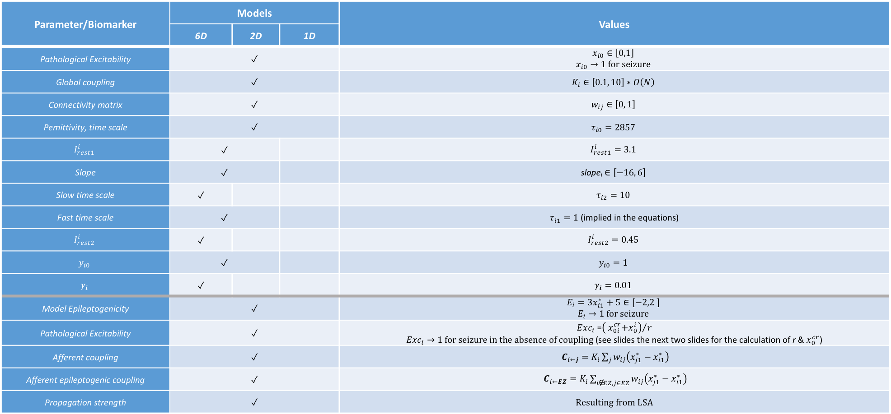
Parameters & some first model biomarkers
Parameter/Biomarker | Models |  |  | Values
 | 6D | 2D | 1D
Pathological Excitability | ✓ |  |  | $$x_{i0}∈\left[0,1\right]$$ $$x_{i0}→1 for seizure$$
Global coupling | ✓ |  |  | $$K_{i}∈\left[0.1, 10\right]∗O\left(N\right)$$
Connectivity matrix | ✓ |  |  | $$w_{ij}∈\left[0, 1\right]$$
Pemittivity, time scale | ✓ |  |  | $$τ_{i0}=2857$$
$$I_{rest1}^{i}$$ | ✓ |  |  | $$I_{rest1}^{i}=3.1$$
Slope | ✓ |  |  | $$\text{slope}\text{i}∈\left[−16, 6\right]$$
Slow time scale | ✓ |  |  | $$τ_{i2}=10$$
Fast time scale | ✓ |  |  | $τ_{i1}=1$ (implied in the equations)
$$I_{rest2}^{i}$$ | ✓ |  |  | $$I_{rest2}^{i}=0.45$$
$$y_{i0}$$ | ✓ |  |  | $$y_{i0}=1$$
$$γ_{i}$$ | ✓ |  |  | $$γ_{i}=0.01$$
Model Epileptogenicity | ✓ |  |  | $$E_{i}=3x_{i1}^{∗}+5∈\left[−2,2 \right]$$ $$E_{i}→1 for seizure$$
Pathological Excitability | ✓ |  |  | ${Exc}_{i}$ =${\left({ x}_{0i}^{cr}+x_{0}^{i}\right)}/r$ ${Exc}_{i}→1 for seizure in the absence of coupling$ (see slides the next two slides for the calculation of r & $x_{0}^{cr}$)
Afferent coupling | ✓ |  |  | $C_{i←j}=K_{i}\sum_{j}{w_{ij}\left(x_{j1}^{∗}−x_{i1}^{∗}\right)}$
Afferent epileptogenic coupling | ✓ |  |  | $C_{i←EZ}=K_{i}\sum_{i\text{∉}EZ,j∈EZ}{w_{ij}\left(x_{j1}^{∗}−x_{i1}^{∗}\right)}$
Propagation strength | ✓ |  |  | Resulting from LSA

Slide 13
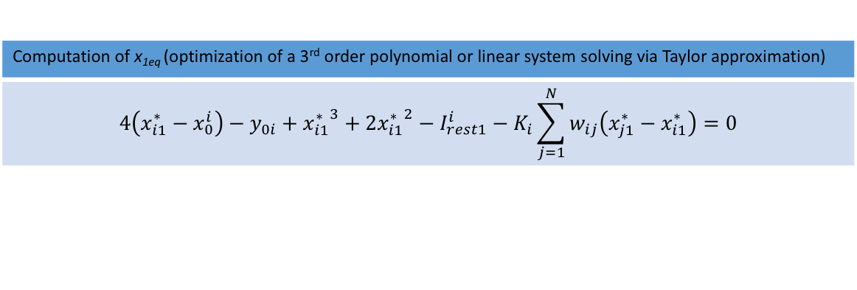
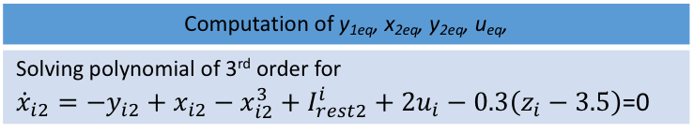
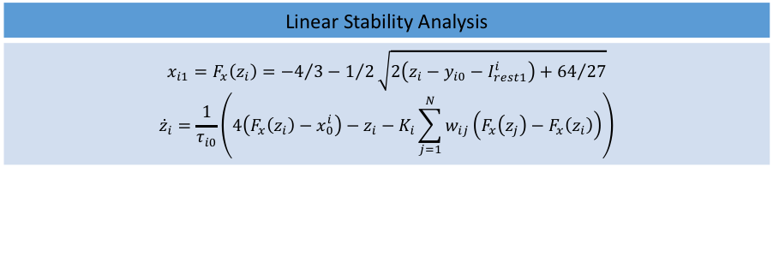
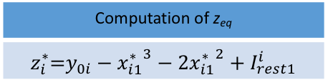
Equilibrium point computation & LSA
Computation of y_{1eq}, x_{2eq}, y_{2eq}, u_{eq},
Solving polynomial of 3rd order for ${\dot{x}}_{i2}={−y}_{i2}+x_{i2}−x_{i2}^{3}+I_{rest2}^{i}+2u_{i}−0.3\left(z_{i}−3.5\right)$=0
Linear Stability Analysis
$$x_{i1}=F_{x}\left(z_{i}\right)={−4}/3−1/2\sqrt{2\left(z_{i}−y_{i0}−I_{rest1}^{i}\right)+{64}/{27}}$$ $${\dot{z}}_{i}=\frac{1}{τ_{i0}}\left(4\left(F_{x}\left(z_{i}\right)−x_{0}^{i}\right)−z_{i}−K_{i}\sum_{j=1}^{N}{w_{ij}\left(F_{x}\left(z_{j}\right)−F_{x}\left(z_{i}\right)\right)}\right)$$
x_{1eq}, z_{eq}
z_{eq}
Computation of z_{eq}
$$z_{i}^{∗}\text{=}y_{0i}−{x_{i1}^{∗}}^{3}−2{x_{i1}^{∗}}^{2}+I_{rest1}^{i}$$
x_{1eq}
Computation of x_{1eq} (optimization of a 3rd order polynomial or linear system solving via Taylor approximation)
$$4\left(x_{i1}^{∗}−x_{0}^{i}\right)−y_{0i}+{x_{i1}^{∗}}^{3}+2{x_{i1}^{∗}}^{2}−I_{rest1}^{i}−K_{i}\sum_{j=1}^{N}{w_{ij}\left(x_{j1}^{∗}−x_{i1}^{∗}\right)}=0$$
Clinician’s Hypothesis Exc (x₀) and/or E (x_{1eq})
Proix, T., Bartolomei, F., Guye, M., & Jirsa, V. K. (2017). Individual brain structure and modelling predict seizure propagation. Brain, 140, 641–654.

Slide 14
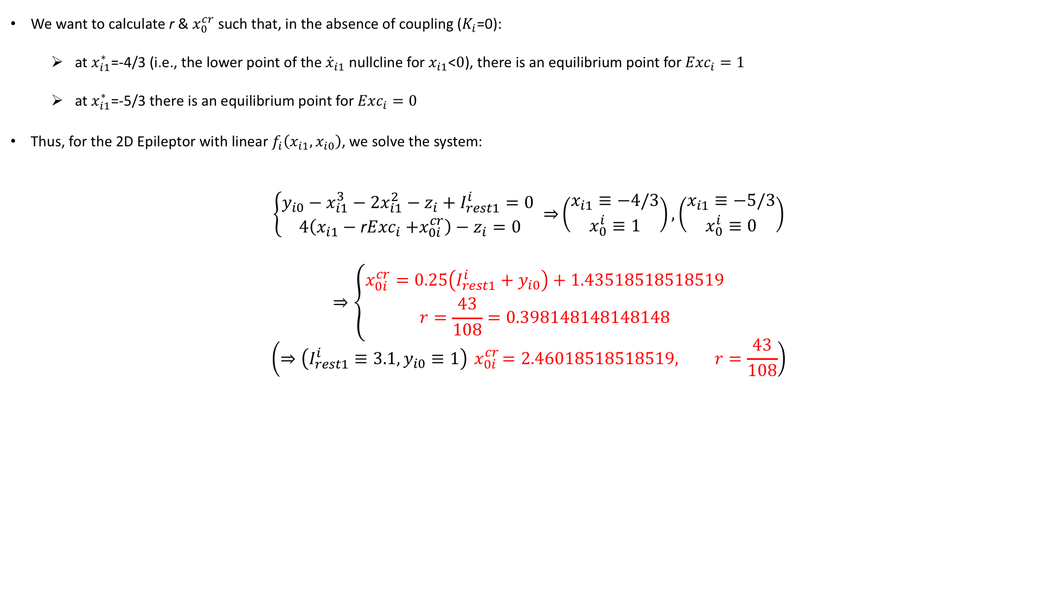
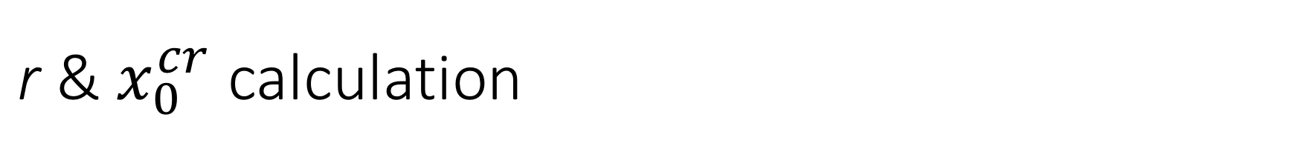
${\text{r}\text{ \&} x}_{0}^{cr}$ calculation
We want to calculate r & $x_{0}^{cr}$ such that, in the absence of coupling ($K_{i}$=0):
at $x_{i1}^{∗}$=-4/3 (i.e., the lower point of the ${\dot{x}}_{i1}$ nullcline for $x_{i1}$<$0$), there is an equilibrium point for${Exc}_{i}=1$
at $x_{i1}^{∗}$=-5/3 there is an equilibrium point for ${Exc}_{i}=0$
Thus, for the 2D Epileptor with linear $f_{i}\left(x_{i1},x_{i0}\right)$, we solve the system:
$$\left\{\begin{matrix}y_{i0}−x_{i1}^{3}−2x_{i1}^{2}−z_{i}+I_{rest1}^{i}=0 \\ 4\left(x_{i1}−{\text{r}Exc}_{i}{+x}_{0i}^{cr}\right)−z_{i}=0\end{matrix}⇒\right.\left(\begin{matrix}x_{i1}≡−4/3 \\ x_{0}^{i}≡1\end{matrix}\right),\left(\begin{matrix}x_{i1}≡−5/3 \\ x_{0}^{i}≡0\end{matrix}\right)$$
$$⇒\left\{\begin{matrix}x_{0i}^{cr}=0.25\left(I_{rest1}^{i}+y_{i0}\right)+1.43518518518519 \\ r=\frac{43}{108}=0.398148148148148\end{matrix}\right.$$
$$\left(⇒\left(I_{rest1}^{i}≡3.1,y_{i0}≡1\right){ x}_{0i}^{cr}=2.46018518518519, r=\frac{43}{108}\right)$$

Slide 15
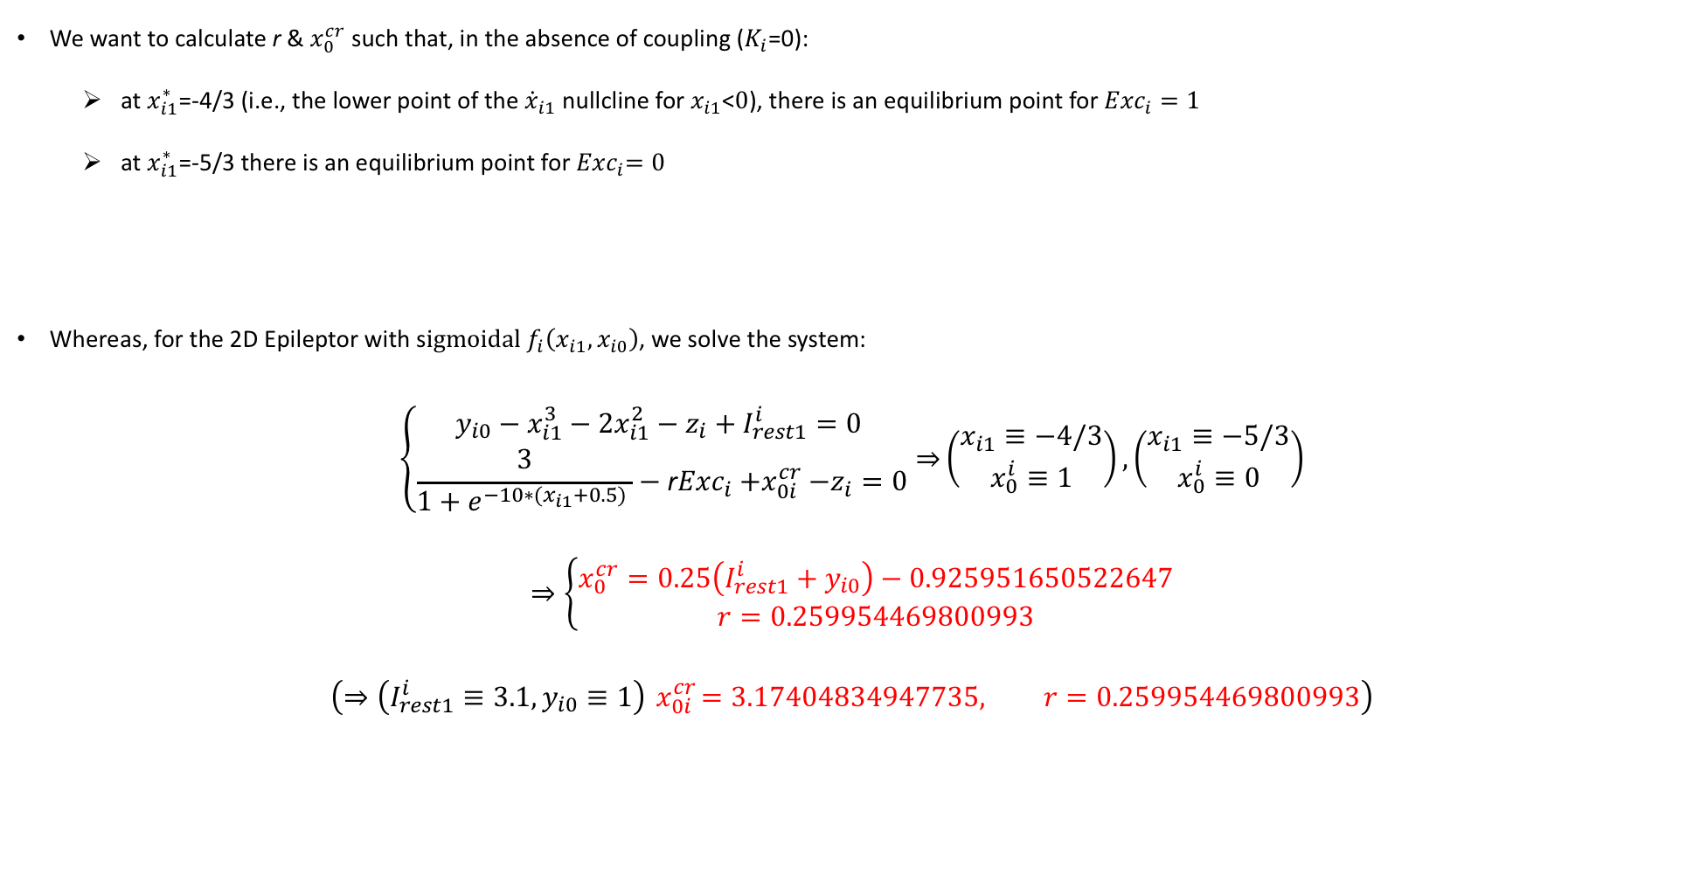
${\text{r}\text{ \&} x}_{0}^{cr}$ calculation
We want to calculate r & $x_{0}^{cr}$ such that, in the absence of coupling ($K_{i}$=0):
at $x_{i1}^{∗}$=-4/3 (i.e., the lower point of the ${\dot{x}}_{i1}$ nullcline for $x_{i1}$<$0$), there is an equilibrium point for ${Exc}_{i}=1$
at $x_{i1}^{∗}$=-5/3 there is an equilibrium point for${ Exc}_{i}=0$
Whereas, for the 2D Epileptor with s$igmoidal f_{i}\left(x_{i1},x_{i0}\right)$, we solve the system:
$$\left\{\begin{matrix}y_{i0}−x_{i1}^{3}−2x_{i1}^{2}−z_{i}+I_{rest1}^{i}=0 \\ \frac{3}{1+e^{−10∗(x_{i1}+0.5) }}−{\text{r}Exc}_{i}{+x}_{0i}^{cr}−z_{i}=0\end{matrix}⇒\right.\left(\begin{matrix}x_{i1}≡−4/3 \\ x_{0}^{i}≡1\end{matrix}\right),\left(\begin{matrix}x_{i1}≡−5/3 \\ x_{0}^{i}≡0\end{matrix}\right)$$
$$⇒\left\{\begin{matrix}x_{0}^{cr}=0.25\left(I_{rest1}^{i}+y_{i0}\right)−0.925951650522647 \\ r=0.259954469800993\end{matrix}\right.$$
$$\left(⇒\left(I_{rest1}^{i}≡3.1,y_{i0}≡1\right){ x}_{0i}^{cr}=3.17404834947735, r=0.259954469800993\right)$$

Slide 16

Linear stability analysis on the slow manifold of the 2D epileptor
We use the linear version for ${\dot{z}}_{i}$, and for $x_{i1}<0$, ${ z}_{i}≥0$:
${\dot{x}}_{i1}=y_{i0}−x_{i1}^{3}−2x_{i1}^{2}−z_{i}+I_{rest1}^{i}$ (1)
${\dot{z}}_{i}=\frac{1}{τ_{0i}}\left(4\left(x_{i1}−x_{0}^{i}\right)−z_{i}−K_{i}\sum_{j=1}^{N}{w_{ij}\left(x_{j1}−x_{i1}\right)}\right)$ (2)
B. Thus, knowing the $x_{i1}$ coordinate of the equilibrium point ($x_{i1}^{∗}$), we can always calculate from (1):
$z_{i}^{∗}\text{=}y_{0i}−{x_{i1}^{∗}}^{3}−2{x_{i1}^{∗}}^{2}+I_{rest1}^{i}$ (3)
and then from (2):
$x_{0}^{i}={\left(4x_{i1}^{∗}−z_{i}^{∗}−K_{i}\sum_{j=1}^{N}{w_{ij}\left(x_{j1}^{∗}−x_{i1}^{∗}\right)}\right)}/4$ (4)

Slide 17
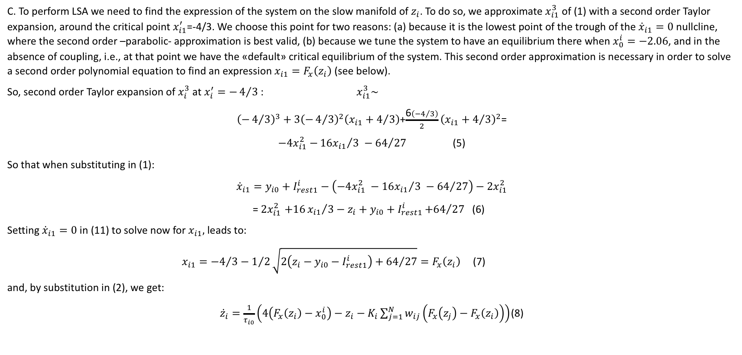
Linear stability analysis on the slow manifold of the 2D epileptor
C. To perform LSA we need to find the expression of the system on the slow manifold of $z_{i}$. To do so, we approximate $x_{i1}^{3}$ of (1) with a second order Taylor expansion, around the critical point $x_{i1}^{′}$=-4/3. We choose this point for two reasons: (a) because it is the lowest point of the trough of the ${\dot{x}}_{i1}=0$ nullcline, where the second order –parabolic- approximation is best valid, (b) because we tune the system to have an equilibrium there when $x_{0}^{i}=−2.06$, and in the absence of coupling, i.e., at that point we have the «default» critical equilibrium of the system. This second order approximation is necessary in order to solve a second order polynomial equation to find an expression $x_{i1}=F_{x}\left(z_{i}\right)$ (see below).
So, second order Taylor expansion of $x_{i}^{3}$ at $x_{i}^{′}=−4/3$ : $x_{i1}^{3}\sim$
${\left(−4/3\right)}^{3}+3{\left(−4/3\right)}^{2}\left(x_{i1}+4/3\right)$+$\frac{\text{6}\left(−4/3\right)}{2}{\left(x_{i1}+4/3\right)}^{2}$=
$−{4x}_{i1}^{2}$ $−{{16x}_{i1}}/3 −{64}/{27}$ (5)
So that when substituting in (1):
$${\dot{x}}_{i1}=y_{i0}+I_{rest1}^{i}−\left(−{4x}_{i1}^{2} −{{16x}_{i1}}/3 −{64}/{27}\right)−{2x}_{i1}^{2}$$
${\text{=} 2x}_{i1}^{2}+16{x_{i1}}/3−z_{i}+y_{i0}+I_{rest1}^{i}{+64}/{27}$ (6)
Setting ${\dot{x}}_{i1}=0$ in (11) to solve now for $x_{i1},$ leads to:
$x_{i1}={−4}/3−1/2\sqrt{2\left(z_{i}−y_{i0}−I_{rest1}^{i}\right)+{64}/{27}}=F_{x}\left(z_{i}\right)$ (7)
and, by substitution in (2), we get:
${\dot{z}}_{i}=\frac{1}{τ_{i0}}\left(4\left(F_{x}\left(z_{i}\right)−x_{0}^{i}\right)−z_{i}−K_{i}\sum_{j=1}^{N}{w_{ij}\left(F_{x}\left(z_{j}\right)−F_{x}\left(z_{i}\right)\right)}\right)$ (8)

Slide 18
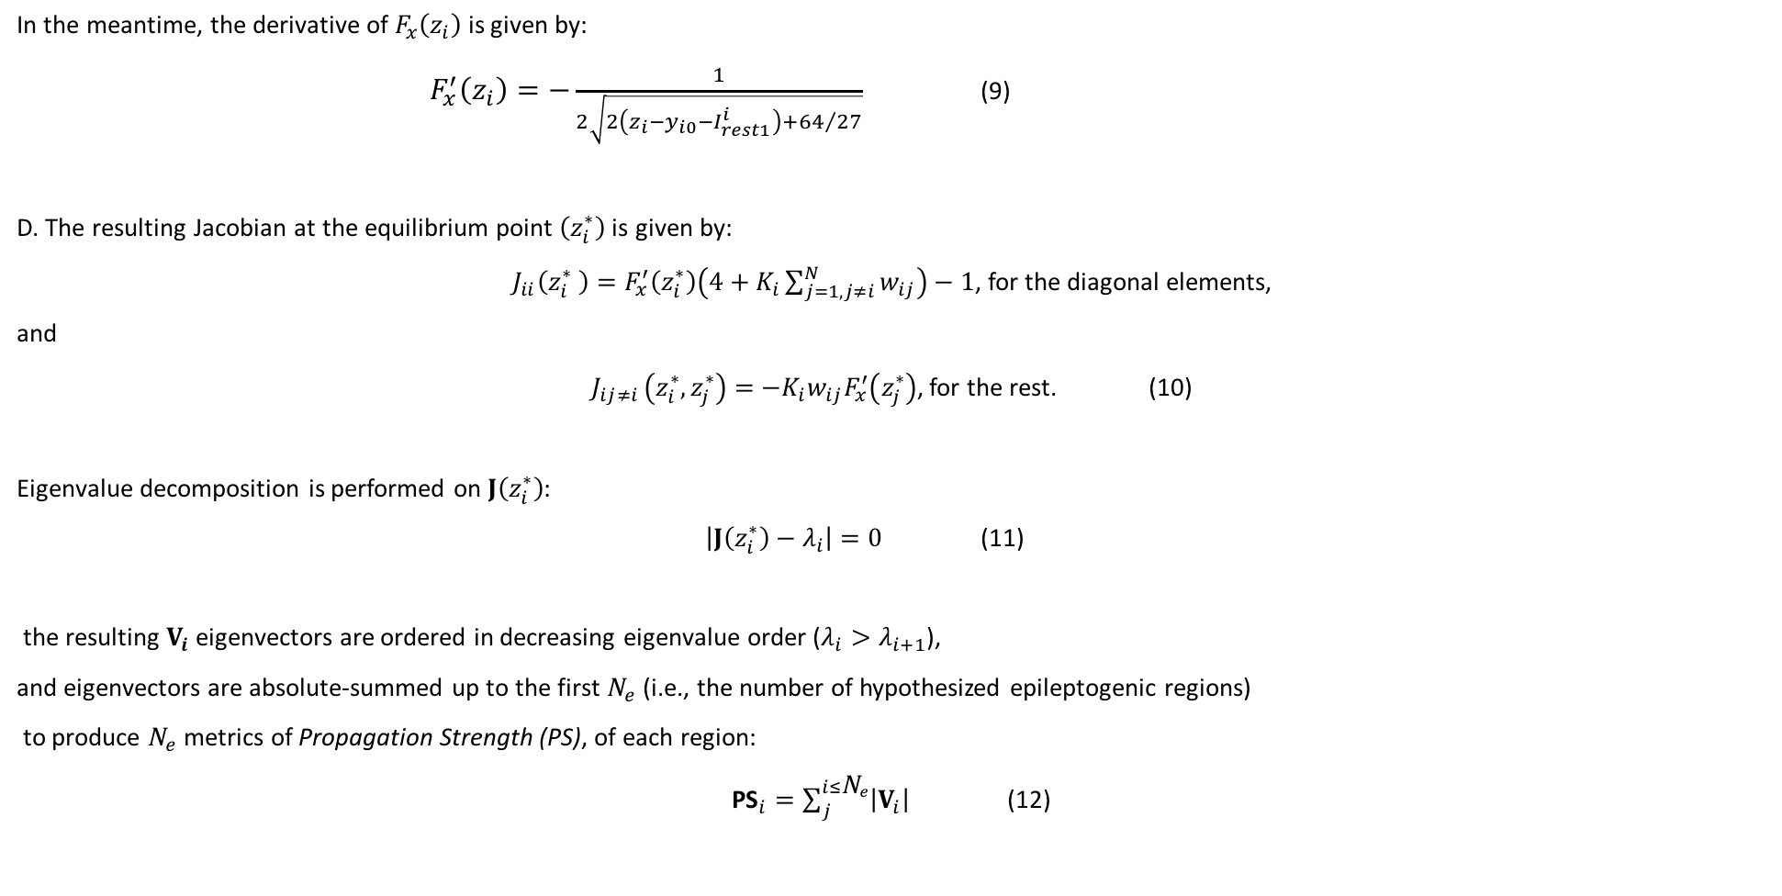
Linear stability analysis on the slow manifold of the 2D epileptor
In the meantime, the derivative of $F_{x}\left(z_{i}\right)$ is given by:
$F_{x}^{′}\left(z_{i}\right)=−\frac{1}{2\sqrt{2\left(z_{i}−y_{i0}−I_{rest1}^{i}\right)+{64}/{27}}}$ (9)
D. $\text{The} \text{resulting} \text{Jacobian} \text{at} \text{the} \text{equilibrium} \text{point} \left(z_{i}^{∗}\right) \text{is} \text{given} \text{by}\text{:}$
$J_{ii}\left(z_{i}^{∗} \right)=F_{x}^{′}\left(z_{i}^{∗}\right)\left(4+K_{i}\sum_{j=1,j≠i}^{N}{w_{ij}}\right)−1$, for the diagonal elements,
and
$J_{ij≠i }\left(z_{i}^{∗},z_{j}^{∗}\right)=$ ${{−K}_{i}w_{ij}F}_{x}^{′}\left(z_{j}^{∗}\right)$, for the rest. (10)
Eigenvalue decomposition is performed on $J\left(z_{i}^{∗}\right)$:
$\left|J\left(z_{i}^{∗}\right)−λ_{i}\right|=0$ (11)
the resulting $V_{i}$ eigenvectors are ordered in decreasing eigenvalue order ($λ_{i}>λ_{i+1}$),
and eigenvectors are absolute-summed up to the first ${\text{N}}_{e}$(i.e., the number of hypothesized epileptogenic regions)
to produce ${\text{N}}_{e}$ metrics of Propagation Strength (PS), of each region:
${\text{PS}}_{i}=\sum_{j}^{i≤{\text{N}}_{e}}{\left|V_{i}\right|}$ (12)

Slide 19
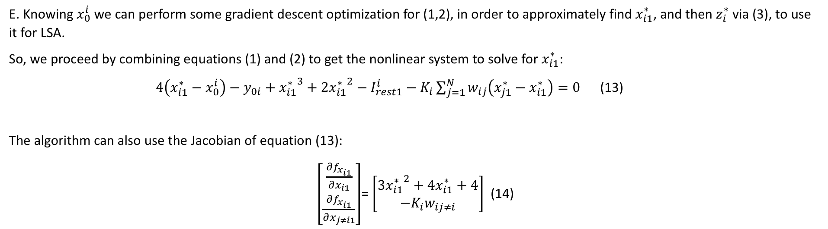
Linear stability analysis on the slow manifold of the 2D epileptor
E. Knowing $x_{0}^{i}$ we can perform some gradient descent optimization for (1,2), in order to approximately find $x_{i1}^{∗}$, and then $z_{i}^{∗}$ via (3), to use it for LSA.
So, we proceed by combining equations (1) and (2) to get the nonlinear system to solve for $x_{i1}^{∗}$:
$4\left(x_{i1}^{∗}−x_{0}^{i}\right)−y_{0i}+{x_{i1}^{∗}}^{3}+2{x_{i1}^{∗}}^{2}−I_{rest1}^{i}−K_{i}\sum_{j=1}^{N}{w_{ij}\left(x_{j1}^{∗}−x_{i1}^{∗}\right)}=0$ (13)
The algorithm can also use the Jacobian of equation (13):
$\left[\begin{matrix}\frac{∂f_{x_{i1}}}{∂x_{i1}} \\ \frac{∂f_{x_{i1}}}{∂x_{j≠i1}}\end{matrix}\right]$= $\left[\begin{matrix}{3x_{i1}^{∗}}^{2}+4x_{i1}^{∗}+4 \\ −K_{i}w_{ij≠i}\end{matrix}\right]$ (14)

Slide 20
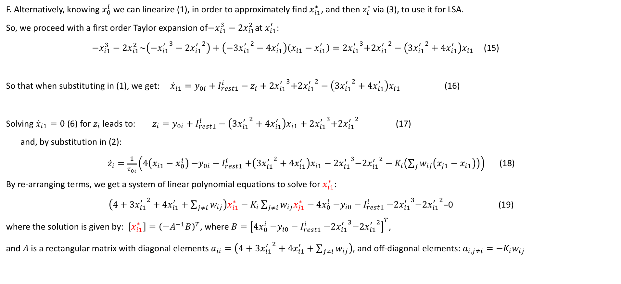
Linear stability analysis on the slow manifold of the 2D epileptor
F. Alternatively, knowing $x_{0}^{i}$ we can linearize (1), in order to approximately find $x_{i1}^{∗}$, and then $z_{i}^{∗}$ via (3), to use it for LSA.
So, we proceed with a first order Taylor expansion of$−x_{i1}^{3}−2x_{i1}^{2}$at $x_{i1}^{′}$:
$−x_{i1}^{3}−2x_{i1}^{2}\sim \left(−{x_{i1}^{′}}^{3}−2{x_{i1}^{′}}^{2}\right)+\left(−{{3x}_{i1}^{′}}^{2}−4x_{i1}^{′}\right)\left(x_{i1}−x_{i1}^{′}\right)=2{x_{i1}^{′}}^{3}{{+2x}_{i1}^{′}}^{2}−\left(3{x_{i1}^{′}}^{2}+4x_{i1}^{′}\right)x_{i1}$ (15)
So that when substituting in (1), we get: ${\dot{x}}_{i1}={y_{0i}+I}_{rest1}^{i}−z_{i}+2{x_{i1}^{′}}^{3}{{+2x}_{i1}^{′}}^{2}−\left(3{x_{i1}^{′}}^{2}+4x_{i1}^{′}\right)x_{i1}$ (16)
Solving ${\dot{x}}_{i1}=0$ (6) for$z_{i}$ leads to: $z_{i}={y_{0i}+I}_{rest1}^{i}−\left(3{x_{i1}^{′}}^{2}+4x_{i1}^{′}\right)x_{i1}+2{x_{i1}^{′}}^{3}{{+2x}_{i1}^{′}}^{2}$ (17)
and, by substitution in (2):
${\dot{z}}_{i}=\frac{1}{τ_{0i}}\left(4\left({x_{i1}−x}_{0}^{i}\right){−y_{0i}−I}_{rest1}^{i}+\left(3{x_{i1}^{′}}^{2}+4x_{i1}^{′}\right)x_{i1}−2{x_{i1}^{′}}^{3}{{−2x}_{i1}^{′}}^{2}−K_{i}\left(\sum_{j}{w_{ij}\left(x_{j1}−x_{i1}\right)}\right)\right)$ (18)
By re-arranging terms, we get a system of linear polynomial equations to solve for $x_{i1}^{∗}$:
$\left(4+3{x_{i1}^{′}}^{2}+4x_{i1}^{′}+\sum_{j≠i}{w_{ij}}\right)x_{i1}^{∗}−K_{i}\sum_{j≠i}{w_{ij}x_{j1}^{∗}}−4x_{0}^{i}{−y_{i0}−I}_{rest1}^{i}−2{x_{i1}^{′}}^{3}{{−2x}_{i1}^{′}}^{2}$=0 (19)
where the solution is given by: $\left[x_{i1}^{∗}\right]={\left(−A^{−1}B\right)}^{T}$, where $B={\left[4x_{0}^{i}{−y_{i0}−I}_{rest1}^{i}−2{x_{i1}^{′}}^{3}{{−2x}_{i1}^{′}}^{2}\right]}^{T}$,
and $A$ is a rectangular matrix with diagonal elements $a_{ii}=\left(4+3{x_{i1}^{′}}^{2}+4x_{i1}^{′}+\sum_{j≠i}{w_{ij}}\right)$, and off-diagonal elements: $a_{i,j≠i}={−K}_{i}w_{ij}$

Slide 21
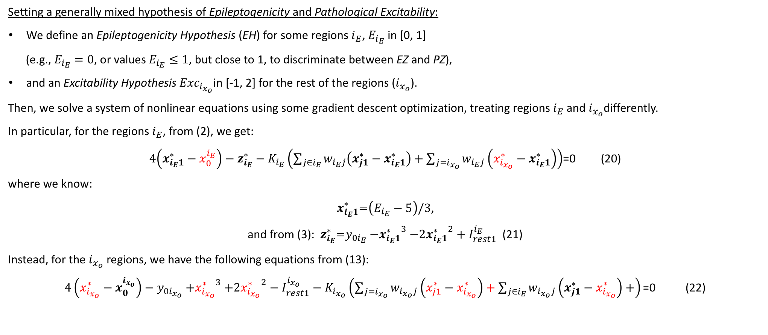
Linear stability analysis on the slow manifold of the 2D epileptor
Setting a generally mixed hypothesis of Epileptogenicity and Pathological Excitability:
We define an Epileptogenicity Hypothesis (EH) for some regions $i_{E}$, $E_{i_{E}}$ in [0, 1]
(e.g., $E_{i_{E}}=0$, or values $E_{i_{E}}≤1$, but close to 1, to discriminate between EZ and PZ),
and an Excitability Hypothesis${ Exc}_{i_{x_{o}}}$in [-1, 2] for the rest of the regions ($i_{x_{o}}$).
Then, we solve a system of nonlinear equations using some gradient descent optimization, treating regions $i_{E}$and $i_{x_{o}}$differently.
In particular, for the regions $i_{E}$, from (2), we get:
$4\left(x_{i_{E}1}^{∗}−x_{0}^{i_{E}}\right)−z_{i_{E}}^{∗}−K_{i_{E}}\left(\sum_{j∈i_{E}}{w_{i_{E}j}\left(x_{j1}^{∗}−x_{i_{E}1}^{∗}\right)}+\sum_{j=i_{x_{o}}}{w_{i_{E}j}\left(x_{i_{x_{o}}}^{∗}−x_{i_{E}1}^{∗}\right)}\right)$=0 (20)
where we know:
$x_{i_{E}1}^{∗}\text{=}\left(E_{i_{E}}−5\right)\text{/3}$,
and from (3): $z_{i_{E}}^{∗}\text{=}y_{0i_{E}}{−x_{i_{E}1}^{∗}}^{3}−2{x_{i_{E}1}^{∗}}^{2}+I_{rest1}^{i_{E}}$ (21)
Instead, for the $i_{x_{o}}$ regions, we have the following equations from (13):
$4\left(x_{i_{x_{o}}}^{∗}−x_{0}^{i_{x_{o}}}\right)−y_{0i_{x_{o}}}{+x_{i_{x_{o}}}^{∗}}^{3}+2{x_{i_{x_{o}}}^{∗}}^{2}−I_{rest1}^{i_{x_{o}}}−K_{i_{x_{o}}}\left(\sum_{j=i_{x_{o}}}{w_{i_{x_{o}}j}\left(x_{j1}^{∗}−x_{i_{x_{o}}}^{∗}\right)}+\sum_{j∈i_{E}}{w_{i_{x_{o}}j}\left(x_{j1}^{∗}−x_{i_{x_{o}}}^{∗}\right)}+\right)\text{=0}$ (22)

Slide 22
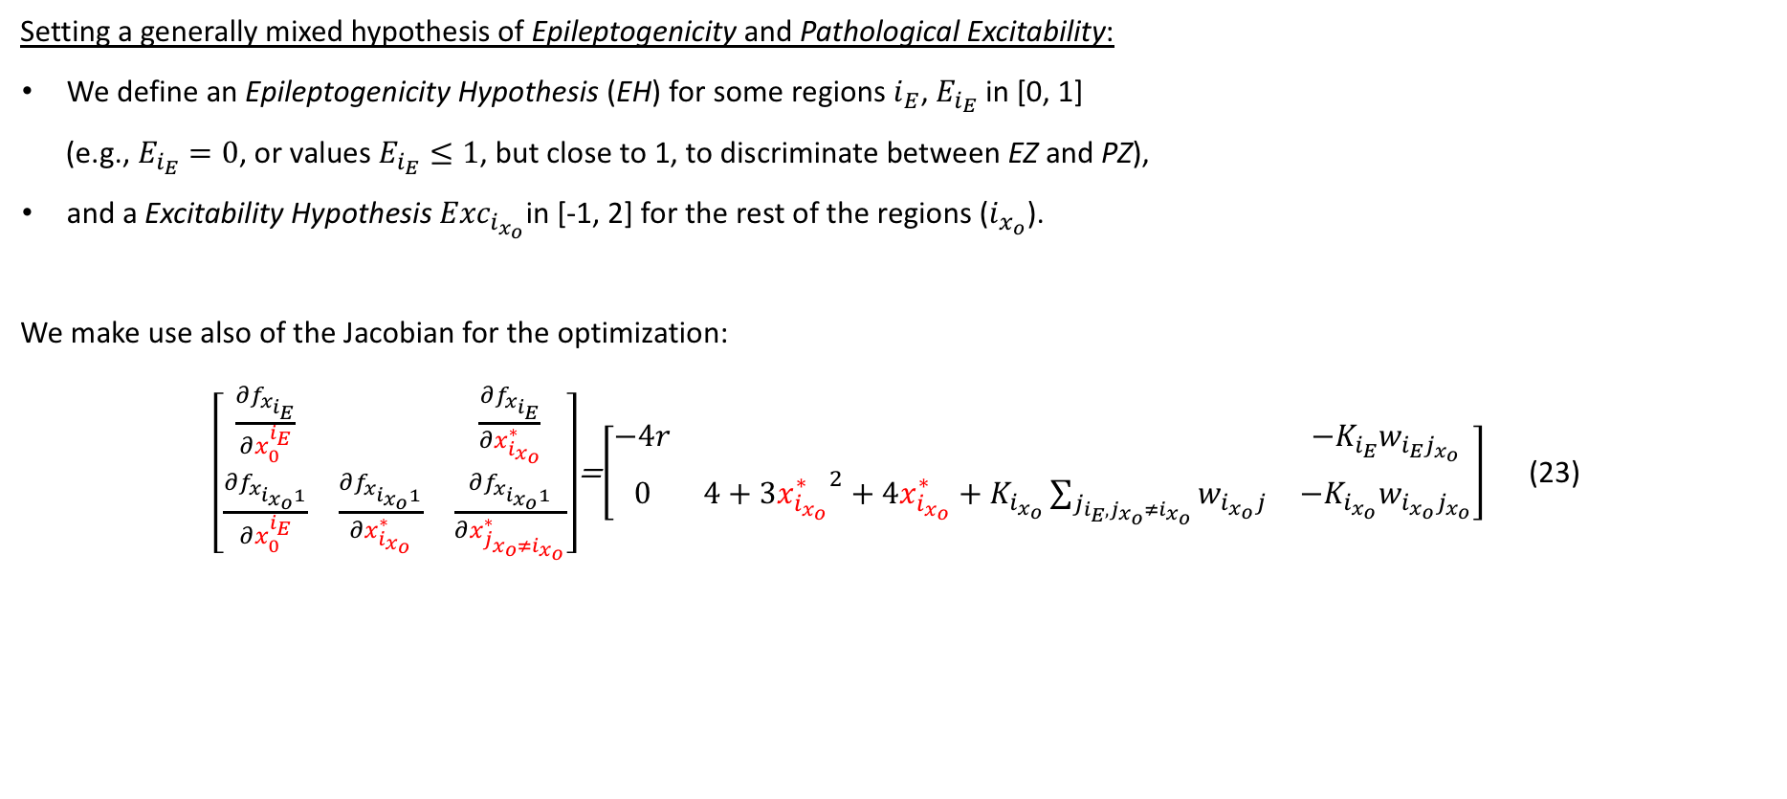
Linear stability analysis on the slow manifold of the 2D epileptor
Setting a generally mixed hypothesis of Epileptogenicity and Pathological Excitability:
We define an Epileptogenicity Hypothesis (EH) for some regions $i_{E}$, $E_{i_{E}}$ in [0, 1]
(e.g., $E_{i_{E}}=0$, or values $E_{i_{E}}≤1$, but close to 1, to discriminate between EZ and PZ),
and a Excitability Hypothesis${ Exc}_{i_{x_{o}}}$in [-1, 2] for the rest of the regions ($i_{x_{o}}$).
We make use also of the Jacobian for the optimization:
$\left[\begin{matrix}\frac{∂f_{x_{i_{E}}}}{∂x_{0}^{i_{E}}} & & \frac{∂f_{x_{i_{E}}}}{∂x_{i_{x_{o}}}^{∗}} \\ \frac{∂f_{x_{i_{x_{o}}1}}}{∂x_{0}^{i_{E}}} & \frac{∂f_{x_{i_{x_{o}}1}}}{∂x_{i_{x_{o}}}^{∗}} & \frac{∂f_{x_{i_{x_{o}}1}}}{∂x_{j_{x_{o}≠i_{x_{o}}}}^{∗}}\end{matrix}\right]$=$\left[\begin{matrix}−4r & & −K_{i_{E}}w_{i_{E}j_{x_{o}}} \\ 0 & {4+3x_{i_{x_{o}}}^{∗}}^{2}+4x_{i_{x_{o}}}^{∗}+K_{i_{x_{o}}}\sum_{j_{i_{E},j_{x_{o}}≠i_{x_{o}}}}{w_{i_{x_{o}}j}} & −K_{i_{x_{o}}}w_{i_{x_{o}}j_{x_{o}}}\end{matrix}\right]$ (23)

Slide 23
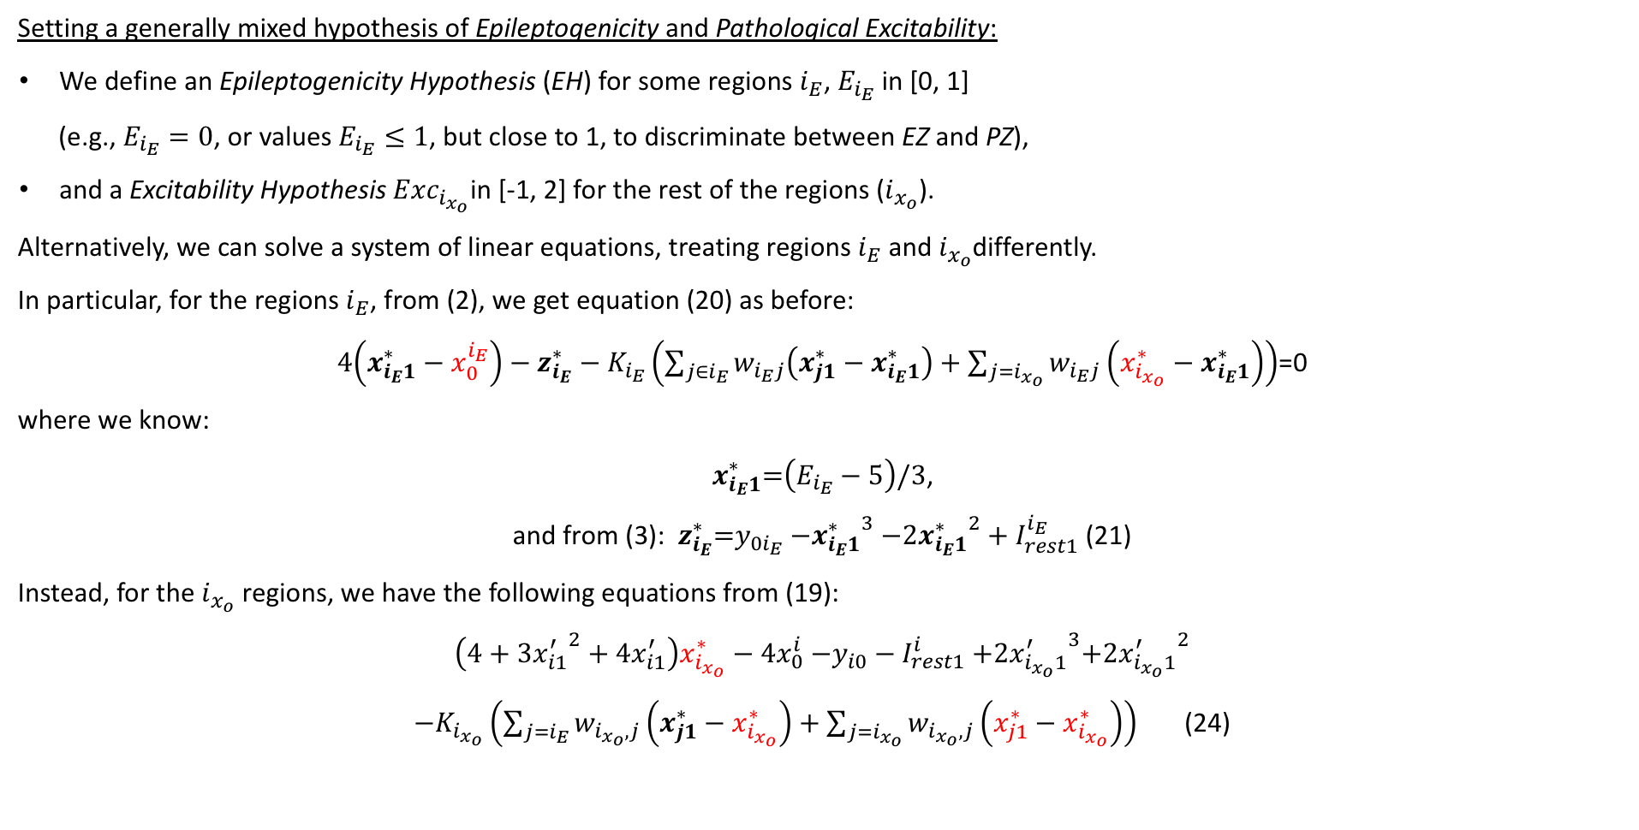
Linear stability analysis on the slow manifold of the 2D epileptor
Setting a generally mixed hypothesis of Epileptogenicity and Pathological Excitability:
We define an Epileptogenicity Hypothesis (EH) for some regions $i_{E}$, $E_{i_{E}}$ in [0, 1]
(e.g., $E_{i_{E}}=0$, or values $E_{i_{E}}≤1$, but close to 1, to discriminate between EZ and PZ),
and a Excitability Hypothesis${ Exc}_{i_{x_{o}}}$in [-1, 2] for the rest of the regions ($i_{x_{o}}$).
Alternatively, we can solve a system of linear equations, treating regions $i_{E}$and $i_{x_{o}}$differently.
In particular, for the regions $i_{E}$, from (2), we get equation (20) as before:
$4\left(x_{i_{E}1}^{∗}−x_{0}^{i_{E}}\right)−z_{i_{E}}^{∗}−K_{i_{E}}\left(\sum_{j∈i_{E}}{w_{i_{E}j}\left(x_{j1}^{∗}−x_{i_{E}1}^{∗}\right)}+\sum_{j=i_{x_{o}}}{w_{i_{E}j}\left(x_{i_{x_{o}}}^{∗}−x_{i_{E}1}^{∗}\right)}\right)$=0
where we know:
$x_{i_{E}1}^{∗}\text{=}\left(E_{i_{E}}−5\right)\text{/3}$,
and from (3): $z_{i_{E}}^{∗}\text{=}y_{0i_{E}}{−x_{i_{E}1}^{∗}}^{3}−2{x_{i_{E}1}^{∗}}^{2}+I_{rest1}^{i_{E}}$(21)
Instead, for the $i_{x_{o}}$ regions, we have the following equations from (19):
$$\left(4+3{x_{i1}^{′}}^{2}+4x_{i1}^{′}\right)x_{i_{x_{o}}}^{∗}−4x_{0}^{i}{−y_{i0}−I}_{rest1}^{i}+2{x_{i_{x_{o}}1}^{′}}^{3}{{+2x}_{i_{x_{o}}1}^{′}}^{2}$$
$−K_{i_{x_{o}}}\left(\sum_{j=i_{E}}{w_{i_{x_{o}},j}\left(x_{j1}^{∗}−x_{i_{x_{o}}}^{∗}\right)}+\sum_{j=i_{x_{o}}}{w_{i_{x_{o}},j}\left(x_{j1}^{∗}−x_{i_{x_{o}}}^{∗}\right)}\right)$ (24)

Slide 24
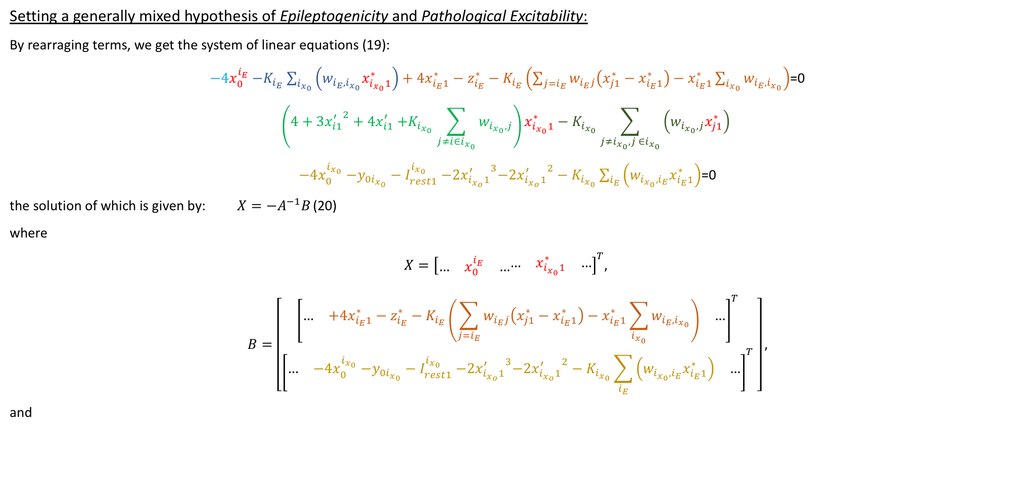
Linear stability analysis on the slow manifold of the 2D epileptor
Setting a generally mixed hypothesis of Epileptogenicity and Pathological Excitability:
By rearraging terms, we get the system of linear equations (19):
$−4x_{0}^{i_{E}}{−K}_{i_{E}}\sum_{i_{x_{0}}}{\left(w_{i_{E},i_{x_{0}}}x_{i_{x_{0}}1}^{∗}\right)}+4x_{i_{E}1}^{∗}−z_{i_{E}}^{∗}−K_{i_{E}}\left(\sum_{j=i_{E}}{w_{i_{E}j}\left(x_{j1}^{∗}−x_{i_{E}1}^{∗}\right)}−x_{i_{E}1}^{∗}\sum_{i_{x_{0}}}{w_{i_{E},i_{x_{0}}}}\right)$=0
$$\left(4+3{x_{i1}^{′}}^{2}+4x_{i1}^{′}{+K}_{i_{x_{0}}}\sum_{j≠i∈i_{x_{0}}}{w_{i_{x_{0}},j}}\right)x_{i_{x_{0}}1}^{∗}−K_{i_{x_{0}}}\sum_{j≠i_{x_{0}}, j ∈i_{x_{0}}}{\left(w_{i_{x_{0}},j}x_{j1}^{∗}\right)}$$
$−4x_{0}^{i_{x_{0}}}{−y_{0i_{x_{0}}}−I}_{rest1}^{i_{x_{0}}}−2{x_{i_{x_{o}}1}^{′}}^{3}{{−2x}_{i_{x_{o}}1}^{′}}^{2}−K_{i_{x_{0}}}\sum_{i_{E}}{\left(w_{i_{x_{0}},i_{E}}x_{i_{E}1}^{∗}\right)}$=0
the solution of which is given by: $X=−A^{−1}B$ (20)
where
$$X={\left[\begin{matrix}… & x_{0}^{i_{E}} & …\end{matrix}\begin{matrix}… & x_{i_{x_{0}}1}^{∗} & …\end{matrix}\right]}^{T},$$
$$B=\left[\begin{matrix}{\left[\begin{matrix}… & +4x_{i_{E}1}^{∗}−z_{i_{E}}^{∗}−K_{i_{E}}\left(\sum_{j=i_{E}}{w_{i_{E}j}\left(x_{j1}^{∗}−x_{i_{E}1}^{∗}\right)}−x_{i_{E}1}^{∗}\sum_{i_{x_{0}}}{w_{i_{E},i_{x_{0}}}}\right) & …\end{matrix}\right]}^{T} \\ {\left[\begin{matrix}… & {−4x}_{0}^{i_{x_{0}}}{−y_{0i_{x_{0}}}−I}_{rest1}^{i_{x_{0}}}−2{x_{i_{x_{o}}1}^{′}}^{3}{{−2x}_{i_{x_{o}}1}^{′}}^{2}−K_{i_{x_{0}}}\sum_{i_{E}}{\left(w_{i_{x_{0}},i_{E}}x_{i_{E}1}^{∗}\right)} & …\end{matrix}\right]}^{T}\end{matrix} \right],$$
and

Slide 25
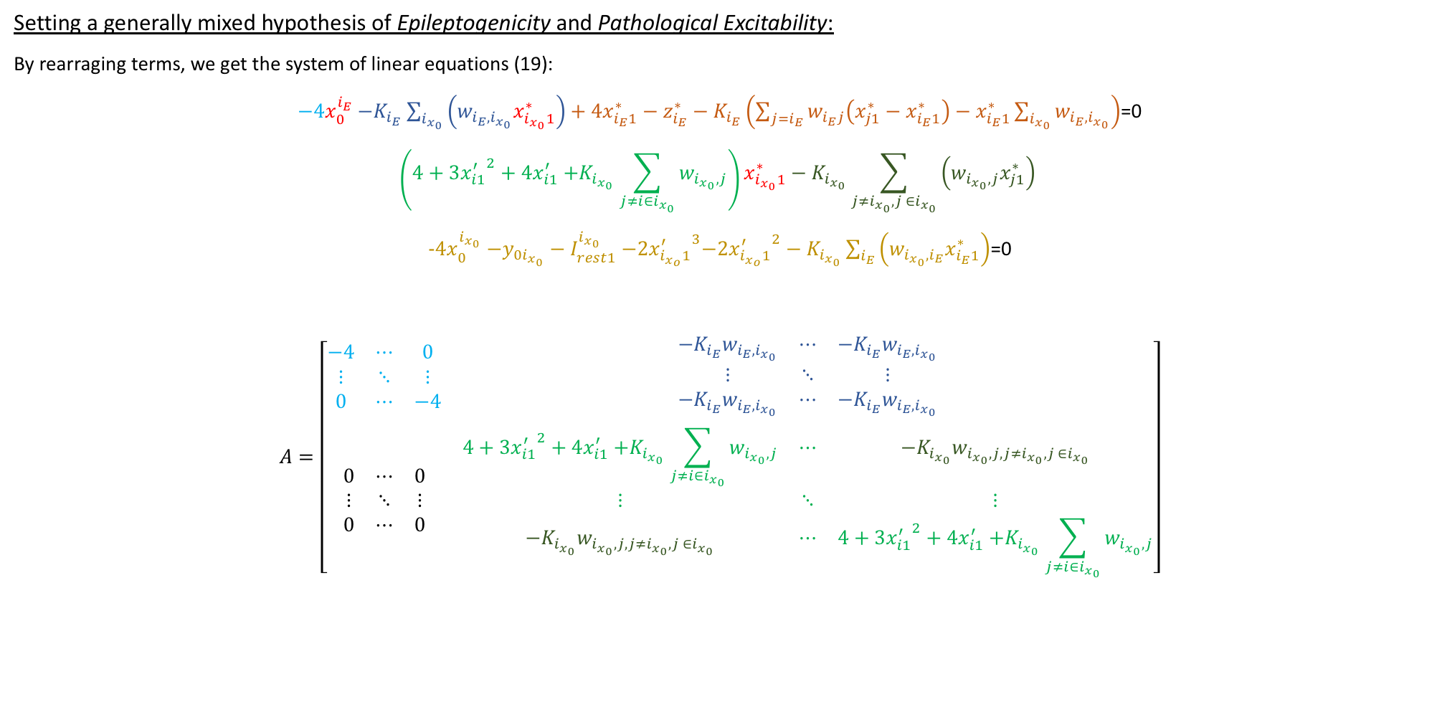
Linear stability analysis on the slow manifold of the 2D epileptor
Setting a generally mixed hypothesis of Epileptogenicity and Pathological Excitability:
By rearraging terms, we get the system of linear equations (19):
$−4x_{0}^{i_{E}}{−K}_{i_{E}}\sum_{i_{x_{0}}}{\left(w_{i_{E},i_{x_{0}}}x_{i_{x_{0}}1}^{∗}\right)}+4x_{i_{E}1}^{∗}−z_{i_{E}}^{∗}−K_{i_{E}}\left(\sum_{j=i_{E}}{w_{i_{E}j}\left(x_{j1}^{∗}−x_{i_{E}1}^{∗}\right)}−x_{i_{E}1}^{∗}\sum_{i_{x_{0}}}{w_{i_{E},i_{x_{0}}}}\right)$=0
$$\left(4+3{x_{i1}^{′}}^{2}+4x_{i1}^{′}{+K}_{i_{x_{0}}}\sum_{j≠i∈i_{x_{0}}}{w_{i_{x_{0}},j}}\right)x_{i_{x_{0}}1}^{∗}−K_{i_{x_{0}}}\sum_{j≠i_{x_{0}}, j ∈i_{x_{0}}}{\left(w_{i_{x_{0}},j}x_{j1}^{∗}\right)}$$
$−4x_{0}^{i_{x_{0}}}{−y_{0i_{x_{0}}}−I}_{rest1}^{i_{x_{0}}}−2{x_{i_{x_{o}}1}^{′}}^{3}{{−2x}_{i_{x_{o}}1}^{′}}^{2}−K_{i_{x_{0}}}\sum_{i_{E}}{\left(w_{i_{x_{0}},i_{E}}x_{i_{E}1}^{∗}\right)}$=0
$$A=\left[\begin{matrix}\begin{matrix}−4 & ⋯ & 0 \\ ⋮ & ⋱ & ⋮ \\ 0 & ⋯ & −4\end{matrix} & \begin{matrix}{−K}_{i_{E}}w_{i_{E},i_{x_{0}}} & ⋯ & {−K}_{i_{E}}w_{i_{E},i_{x_{0}}} \\ ⋮ & ⋱ & ⋮ \\ {−K}_{i_{E}}w_{i_{E},i_{x_{0}}} & ⋯ & {−K}_{i_{E}}w_{i_{E},i_{x_{0}}}\end{matrix} \\ \begin{matrix}0 & ⋯ & 0 \\ ⋮ & ⋱ & ⋮ \\ 0 & ⋯ & 0\end{matrix} & \begin{matrix}4+3{x_{i1}^{′}}^{2}+4x_{i1}^{′}{+K}_{i_{x_{0}}}\sum_{j≠i∈i_{x_{0}}}{w_{i_{x_{0}},j}} & ⋯ & −K_{i_{x_{0}}}w_{i_{x_{0}},j,j≠i_{x_{0}}, j ∈i_{x_{0}}} \\ ⋮ & ⋱ & ⋮ \\ −K_{i_{x_{0}}}w_{i_{x_{0}},j,j≠i_{x_{0}}, j ∈i_{x_{0}}} & ⋯ & 4+3{x_{i1}^{′}}^{2}+4x_{i1}^{′}{+K}_{i_{x_{0}}}\sum_{j≠i∈i_{x_{0}}}{w_{i_{x_{0}},j}}\end{matrix}\end{matrix}\right]$$

Slide 26
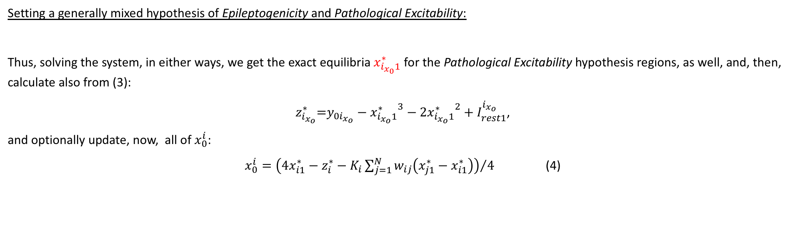
Linear stability analysis on the slow manifold of the 2D epileptor
Setting a generally mixed hypothesis of Epileptogenicity and Pathological Excitability:
Thus, solving the system, in either ways, we get the exact equilibria$x_{i_{x_{0}}1}^{∗}$ for the Pathological Excitability hypothesis regions, as well, and, then, calculate also from (3):
$z_{i_{x_{o}}}^{∗}\text{=}y_{0i_{x_{o}}}−{x_{i_{x_{o}}1}^{∗}}^{3}−2{x_{i_{x_{o}}1}^{∗}}^{2}+I_{rest1}^{i_{x_{o}}}$,
and optionally update, now, all of $x_{0}^{i}$:
$x_{0}^{i}={\left(4x_{i1}^{∗}−z_{i}^{∗}−K_{i}\sum_{j=1}^{N}{w_{ij}\left(x_{j1}^{∗}−x_{i1}^{∗}\right)}\right)}/4$ (4)

Slide 27
References
Jirsa, V. K., Stacey, W. C., Quilichini, P. P., Ivanov, A. I., & Bernard, C. (2014). On the nature of seizure dynamics. Brain, 137, 2210–2230. http://doi.org/10.1093/brain/awu133
El Houssaini, K., Ivanov, A. I., Bernard, C., & Jirsa, V. K. (2015). Seizures, refractory status epilepticus, and depolarization block as endogenous brain activities. Physical Review E, 91(1), 2–6. http://doi.org/10.1103/PhysRevE.91.010701
Saggio, M. L., Spiegler, A., Bernard, C., & Jirsa, V. K. (2017). Fast–Slow Bursters in the Unfolding of a High Codimension Singularity and the Ultra-slow Transitions of Classes. The Journal of Mathematical Neuroscience, 7(1), 7. http://doi.org/10.1186/s13408-017-0050-8
Proix, T., Bartolomei, F., Chauvel, P., Bernard, C., & Jirsa, V. K. (2014). Permittivity Coupling across Brain Regions Determines Seizure Recruitment in Partial Epilepsy. Journal of Neuroscience, 34(45), 15009–15021. http://doi.org/10.1523/JNEUROSCI.1570-14.2014
Proix, T., Bartolomei, F., Guye, M., & Jirsa, V. K. (2017). Individual brain structure and modelling predict seizure propagation. Brain, 140, 641–654.
Jirsa, V. K., Proix, T., Perdikis, D., Woodman, M. M., Wang, H., Bénar, C. G., … Bartolomei, F. (2017). The virtual epileptic patient: individualized whole-brain models of epilepsy spread. NeuroImage, 145 Part B(15). http://doi.org/10.1016/j.neuroimage.2016.04.049

Slide 28
You are welcome to use and develop tvb-epilepsy!

